Slide 1

Private Sale Site
Time-Limited Clothing Sales for Registered Users

Slide 2




The Team
Sowrya Teja CHUNDURU
Meghana SIVAJIRAO
Anusha EAGALA
Punitha KAREMGAM

Slide 3
Agenda
Project Background
Functional Introduction
Technical Introduction
Project Management
Demonstration

Slide 4

Overview
The Private Sale Site is a specialized e-commerce platform that connects top clothing brands with registered users for exclusive, time-limited sales. It offers a secure and easy-to-use environment where customers can access discounted brand items, while professionals manage and analyze their sales efficiently.

Slide 5

Objectives
Exclusive Sales: Create a platform for brands to offer private, discounted sales to members.
Easy Shopping: Make it simple for customers to find and buy items from their favorite brands.
Support Brands: Provide tools for professionals to easily manage and monitor their sales.

Slide 6
GETTING STARTED

Slide 7
FUNCTIONAL INTRODUCTION

Slide 8
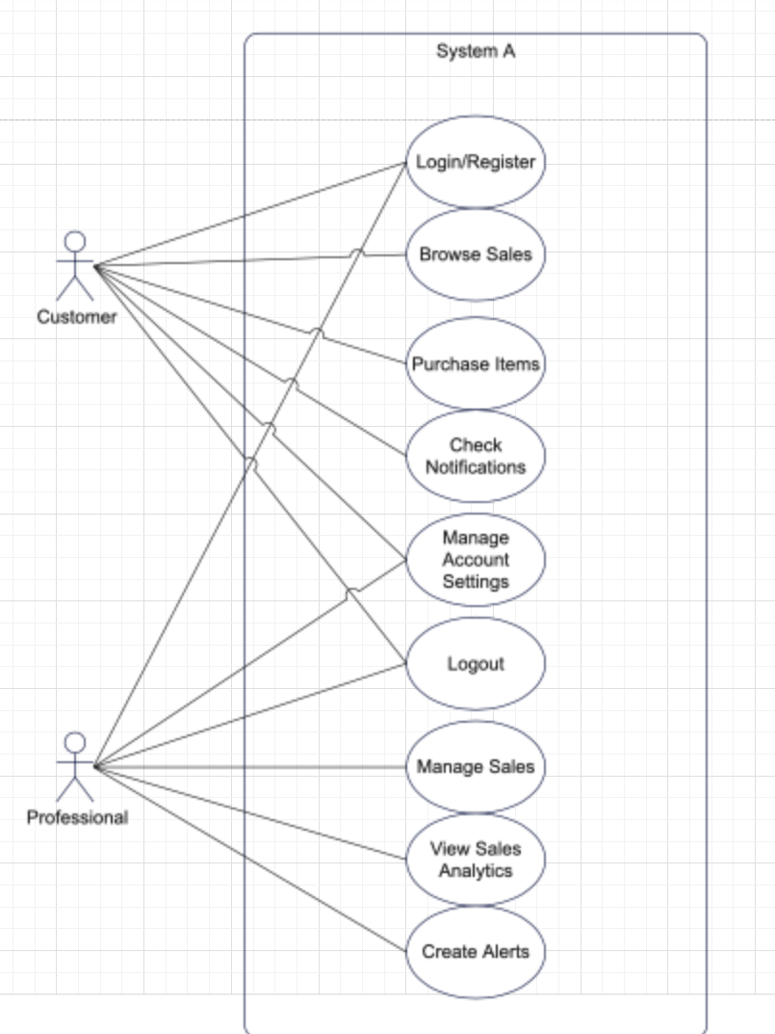
Use Case Diagram
Customers interact with the system primarily to browse and purchase items, manage their account details, and stay informed about upcoming sales.
Professionals interact with the system to create and manage sales, add items to those sales, and track their performance through analytics.
The System Administrator manages overall site functionality and user accounts.

Slide 9
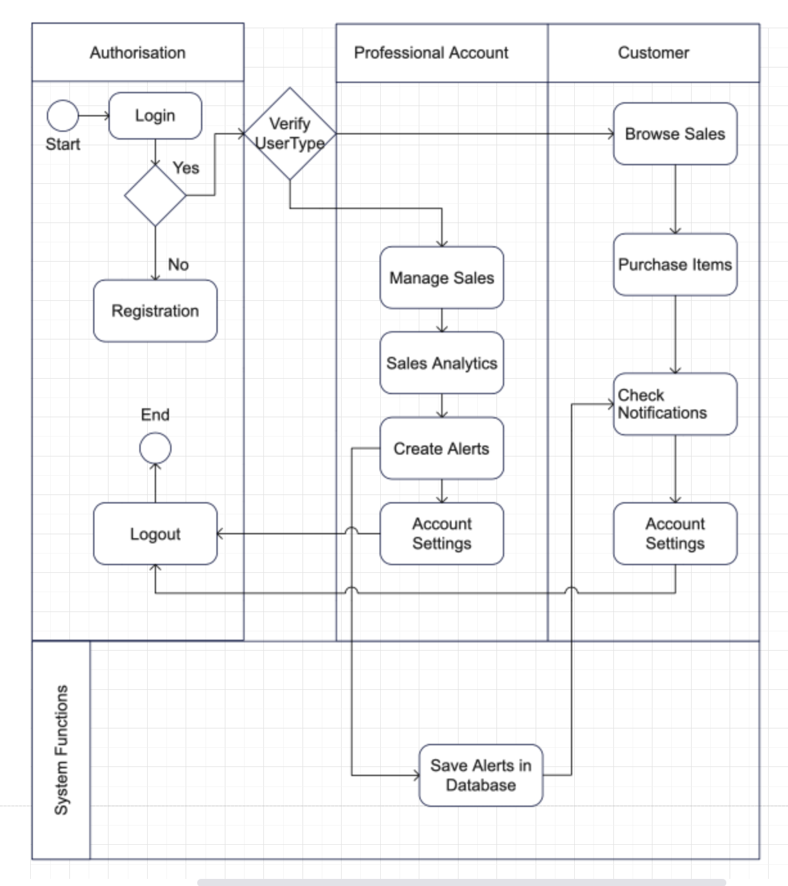
Activity Diagram
The Activity Diagram provides a clear view of the workflows for both customers and professionals as they interact with the system. It details the steps involved in tasks like registering, managing sales, purchasing items, and tracking performance, ensuring a smooth and logical flow of operations on the platform.

Slide 10
TECHNICAL INTRODUCTION

Slide 11

System Requirements and Installation Steps
The Private Sale Site requires a system with at least 4GB of RAM and 10GB of free storage to ensure smooth operation.
Installation involves setting up the XAMPP server, which provides the necessary environment with MySQL and PHP. After installing XAMPP, the MySQL database should be imported via PHPMyAdmin, and the website’s source code should be placed in the htdocs directory.
The site can then be accessed locally through a web browser by navigating to localhost. This setup allows for efficient development and testing of the website on a local machine.

Slide 12

Technical Tools Used
Frontend:
HTML/CSS/JavaScript: These tools create the website’s structure, design, and interactivity, ensuring a responsive and engaging user interface.
Backend:
PHP: Handles server-side processing, managing user authentication, data handling, and rendering dynamic content.
Database:
MySQL: Stores and manages all site data, with MySQL Workbench for database design and PHPMyAdmin for database administration.

Slide 13
ER Diagram
The Entity-Relationship (ER) Diagram for the Private Sale Site visually represents the database structure, highlighting the relationships between various entities within the system.
Key Entities:
Users: Stores user details, including whether the user is a customer or a professional.
Brands: Contains information about the different brands available on the site.
Categories/Subcategories: Classifies items into various categories and subcategories.
Sales: Represents individual sales events, linked to the professional user who created them.
Items: Lists the products available in each sale, including details like brand, category, price, and stock quantity.
Orders: Tracks customer purchases, linking users to the items they have bought.
Order Items: Details the specific items within each order.
Sale Analytics: Captures data on the performance of sales, such as items sold and revenue generated.
Alerts: Manages notifications related to sales and brands.
Page Visits: Records the number of visits to specific sales pages.
User Preferences: Stores customer preferences for specific brands and categories.

Slide 14
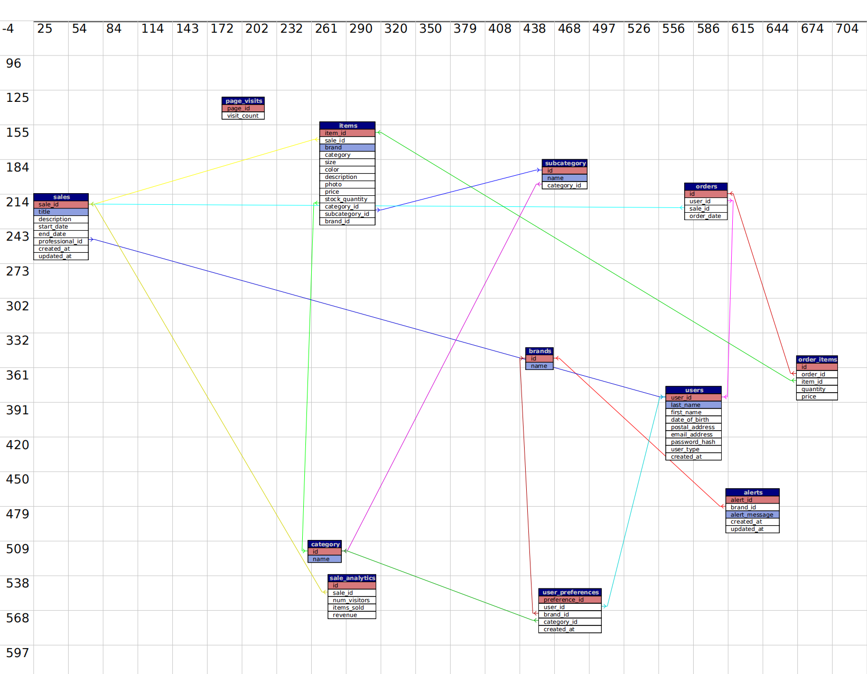
ER Diagram

Slide 15
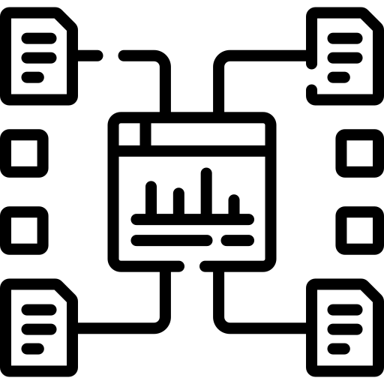
MVC
MVC stands for Model View Controller
It is an architectural pattern.
It solves the problem of users controlling a large and complex data set by splitting a large application into specific sections that all have their own purpose.
Divides a software application into 3 parts:

Slide 16
Model:
db.php: Manages database connections and operations with MySQL.
Controller:
authentication.php: Handles user login and registration.
create_sale.php: Manages creation of new sales.
manage_items.php: Handles item management within sales.
analytics.php: Processes sales analytics data.
account_settings.php: Manages user account updates.
notifications.php: Handles sending notifications to users.
View:
login.php: User interface for login.
registration.php: Interface for user registration.
dashboard.php: Displays user dashboard with sales info.
create_sale_view.php: Interface for creating sales.
manage_items_view.php: Interface for managing sale items.
account_settings_view.php: Page for updating account details.
analytics_view.php: Displays sales performance data.
notifications_view.php: Shows user notifications and alerts.

Slide 17
PROJECT MANAGEMENT

Slide 18
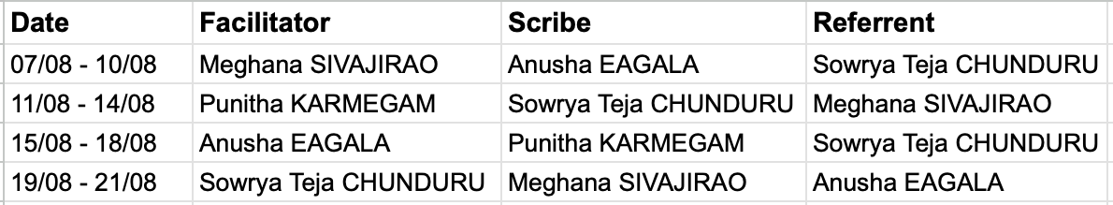
Individual Work Responsibilities
Each set of roles was held for four days, except for the final set, which lasted for two days.

Slide 19
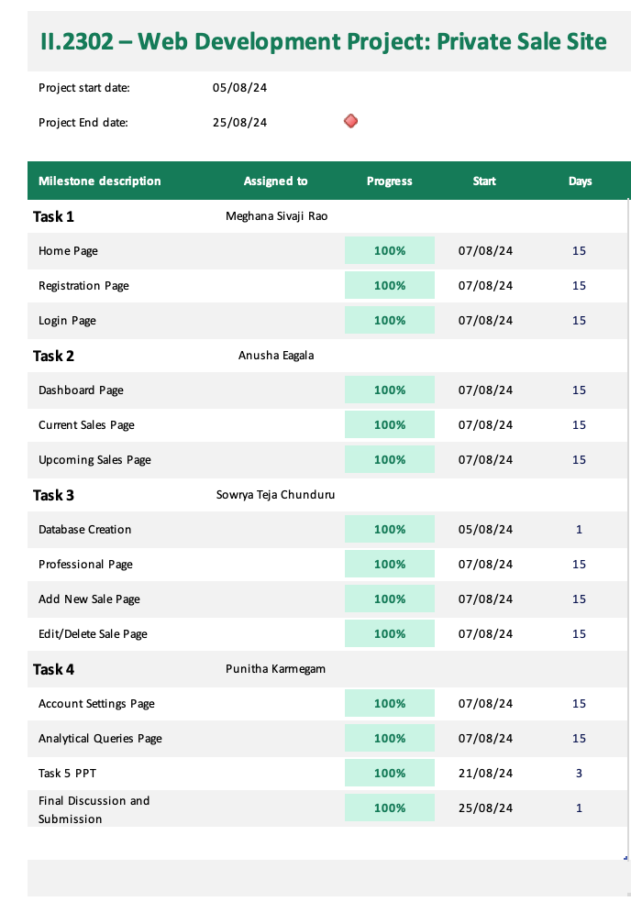
Project Management – Gantt Chart
Project Planning Progress Tracking Resource Allocation Deadline Management

Slide 20
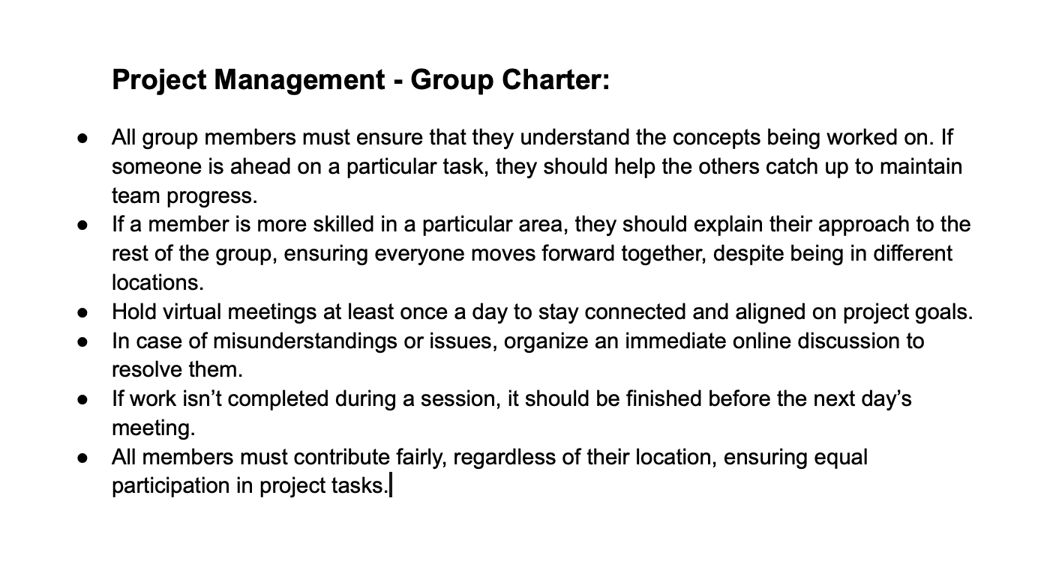

Slide 21
DEMONSTRATION

